Slide 1
Hardware / Modules / Performance
Date:
Location:

Slide 2




Virtual Housekeeping
Use
Headsets
Go on
Mute
Participate Actively
Minimize Distractions
Notes:
***Please ensure you have your headset plugged in so we can avoid echoing and maintain audio quality
***Throughout the session, please keep your mic on mute to avoid background noise during the presentation portions.
***Please be aware you will be asked to participate and engage throughout the session. We ask that you are fully active in the chat box, and are also ready to be called on and unmute if needed. We’ll also have you click on some links to view videos, participate in polls and at some point during the session, we’ll be sending you to specific break out rooms depending on which service you’ll be shadowing.
***Lastly, we ask that you’re fully present. Keeping engaged is even more difficult in a virtual setting, so make sure you turn off notifications, maybe set an out of office in your email. Minimize distractions

Slide 3
Course objectives
/proc
common commands
modules
performance benchmark

Slide 4
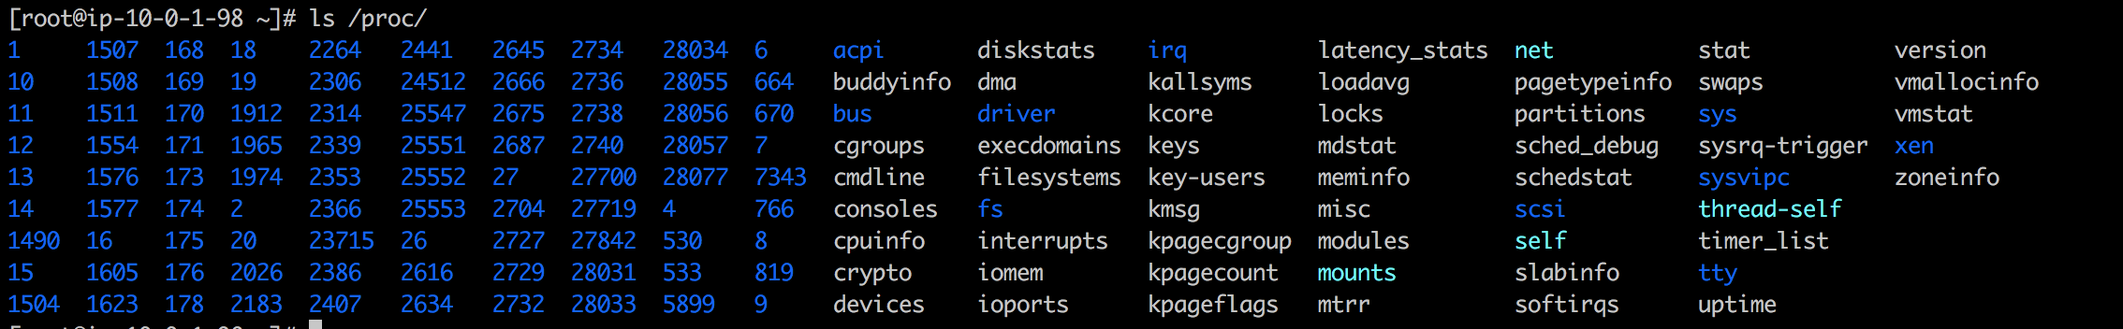
The /proc filesystem
The proc filesystem is a pseudo-filesystem which provides an interface to kernel data structures. It is commonly mounted at /proc.
It does not exist on a disk, instead, the kernel creates it in memory.
$ man proc
https://man7.org/linux/man-pages/man5/proc.5.html

Slide 5
common commands/checks related with /proc
/proc/cpuinfo
/proc/meminfo
/proc/mounts
/proc/interrupts
-> $ lscpu
-> $ free
-> $ mount
Notes:
The proc filesystem is a pseudo-filesystem which provides an interface to kernel data structures. It is
commonly mounted at /proc. Typically, it is mounted automatically by the system, but it can also be
mounted manually using a command such as:
mount -t proc proc /proc
Most of the files in the proc filesystem are read-only, but some files are writable, allowing kernel
variables to be changed.
The /proc file system holds information that most observability tools like top will display. They will just do it in a human friendly format or record values over time
We will have a look at some examples of which information to find in /proc and also what we can manipulate in order to tune the operating system
An interrupt request (IRQ), or interrupt, is a signal sent to the CPU instructing it to suspend its current activity and to handle some external event such as keyboard input.
/proc/interrupts - records the number of interrupts per IRQ
- the IRQ number
- how many times the CPU core has been interrupted
- type of interrupt
- Name of device
which CPU core the interrupt has benn handled on example - timer is interrupt name [System clock] /proc/dma
List of direct memory access channels in use.
DMA permits the device to transfer data directly, without the CPU's attention
/proc/mounts
describes all mounted file systems, including all pseudo file systems
/proc/cpuinfo
This is a collection of CPU and system architecture dependent items, for each supported architecture a different list.
This is commonly used to get the CPU model, supported CPU extensions like VT-d,VT-x or multi/hyper threading
/proc/meminfo
This file reports statistics about memory usage on the system.
/proc/<PID> has in depth information about every process in the system
Explore yourself by simply listing the directory contents or using the procfs manpage
Let’s have a look at the commands that extract information from here to display it in a nicer way. Any examples?

Slide 6
/proc/cpuinfo (shortened)
processor : 3
model name : Intel(R) Xeon(R) CPU E5-2686 v4 @ 2.30GHz
microcode : 0xb000038
cpu MHz : 2300.191
cache size : 46080 KB
siblings : 4
core id : 3
cpu cores : 4
fpu : yes
flags : fpu vme de pse tsc msr pae mce cx8 apic sep mtrr pge mca cmov pat pse36 clflush mmx fxsr sse sse2 ht syscall nx pdpe1gb rdtscp lm constant_tsc rep_good nopl xtopology cpuid pni pclmulqdq ssse3 fma cx16 pcid sse4_1 sse4_2 x2apic movbe popcnt tsc_deadline_timer aes xsave avx f16c rdrand hypervisor lahf_lm abm cpuid_fault invpcid_single pti fsgsbase bmi1 avx2 smep bmi2 erms invpcid xsaveopt
bugs : cpu_meltdown spectre_v1 spectre_v2 spec_store_bypass l1tf mds
Notes:
cpuinfo example for illustration
processor: processor number in the system, starts with 0
model name: given by the vendor
microcode: like the CPU firmware
cpu MHZ: frequncy or clock speed of the CPU per core
cache: this example is the L3 cache, CPUs have usually L1,L2 and L3 cache. L1 is the smallest but fast since closest to the CPU.
flags: any extensions or instruction sets the CPU is designed for
bugs: the current bugs

Slide 7
/proc/sys (tuneables)
sysctl - configure kernel parameters at runtime
# sysctl –a | grep mem
/etc/sysctl.conf
# sysctl –p read values from file
# sysctl -w net.ipv4.ip_forward=1
# echo 1 > /proc/sys/net/ipv4/ip_forward
Notes:
This directory contains a number of files and subdirectories corresponding to kernel variables. These variables can be read and sometimes modified using the /proc filesystem, and the (deprecated) sysctl(2) system call.
So while all configurations files can be read, only some of them may be adjusted.
To get an overview of the adjustable paramters, you can use “sysctl –a”
This is best used with grep to narrow results down
This is not for you to understand what every parameter does but that they exist and can be looked up if needed
You can set values either via sysctl.conf, which will be permanenet and take effect on the next boot
With sysctl –system you can apply all configuration of sysctl conf files in various locations without reboot
To set them once, use the sysctl command or a simple echo
For example to allow IP forwarding, in case you want to use linux as a router.
Both commands do the exact same thing

Slide 8
/proc/sys (tuneables)
Example: Drop cache
1. Clear PageCache only:
# sync; echo 1 > /proc/sys/vm/drop_caches
2. Clear dentries (Also called as Directory Cache) and inodes:
# sync; echo 2 > /proc/sys/vm/drop_caches
3. Clear PageCache, dentries and inodes:
# sync; echo 3 > /proc/sys/vm/drop_caches
Notes:
sync - flush file system buffers
Force changed blocks to disk, update the super block.

Slide 9
modules
Linux modules are lumps of code that can be dynamically linked into the kernel at any point after the system has booted.
They can be unlinked from the kernel and removed when they are no longer needed.
Mostly Linux kernel modules are device drivers, pseudo-device drivers such as network drivers, or file-systems.
https://tldp.org/LDP/tlk/modules/modules.html
Notes:
loadable kernel module (or LKM) is an object file that contains code to extend the running kernel
LKMs are typically used to add support for new hardware (as device drivers) and/or filesystems, or for adding system calls. When the functionality provided by a LKM is no longer required, it can be unloaded in order to free memory and other resources.
advantage is that modules are only loaded when functionality is needed. Keeps the kernel slim.
Due to the amount of different hardware systems, a kernel with all modules builtin to support all existing hardware is simply not feasible

Slide 10
module commands
lsmod = prints contents of /proc/modules
modinfo = displays further information about specific module
modprobe / insmod = Add and remove modules from the Linux Kernel
depmod = creates a list of module dependencies by reading each module under /lib/modules/$(uname -r)/ and determining what symbols it exports and what symbols it needs.
module location: /lib/modules/$(uname -r)/
Notes:
lsmod to print all modules as a list
modinfo for info about specific module
location of modules will depend on kernel version
modprobe/insmod mostly used nowadays to load and remove modules from the kernel
for example insmod ena.ko to insert ENA module into kernel
modprobe –r removes it
modprobe as a wrapper for insmod with additional functionality
depmod creates a list of module dependencies by reading each module under /lib/modules/version and
determining what symbols it exports and what symbols it needs.
useful for resolving module dependencies

Slide 11
modprobe.conf
Used to pass module settings to udev, which uses modprobe to manage the loading of the modules during system boot
configuration file for modules
used often for blacklisting modules if undesired
specific config files used in modprobe.d/ directory
Notes:
udev is a device manager for the Linux kernel. udev primarily manages device nodes in the /dev directory. At the same time, udev also handles all user space events raised while hardware devices are added into the system or removed from it, including firmware loading as required by certain devices.
Can also be used to create convenient aliases: alternate names for a module, or they can override the normal modprobe behavior altogether for those with special requirements
Blacklisting, in the context of kernel modules, is a mechanism to prevent the kernel module from loading.

Slide 12
performance introduction
it’s slow
a bigger instance did not make the application faster
our I/O performance was below the expected 500IOPS between 4am and 5am today
CPU 100%
web server slow
Notes:
performance analysis, tracing and troubleshooting can be quite challenging and is a major part of the Linux world as well as in EC2/AWS
usually the performance is analyzed when either an automatic system triggers an alarm or the customer experience differs from their expectations
Expressing concerns about performance can come in many different ways, for example the ones listed
The amount of information that a customer might give you or that you get from the developers or application team can widely differ.
Across the board, you usually don’t have enough information
To make the process easier, we will look at some important points to keep in mind and methodologies together with different tools to minimize confusion and accelerate the root cause isolation.
man modprobe.d:
Because the modprobe command can add or remove more than one module, due to modules having dependencies, we need a method of specifying what options are to be used with those modules.
All files underneath the /etc/modprobe.d directory which end with the .conf extension specify those options as required. They can also be used to create convenient aliases: alternate
names for a module, or they can override the normal modprobe behavior altogether for those with special requirements (such as inserting more than one module).

Slide 13
approaches
It is a capital mistake to theorize before one has data. Insensibly one begins
to twist facts to suit theories, instead of theories to suit facts.
Evaluate information carefully
Concrete data (latency/metrics/error outputs/timeouts etc.)
time frame or time stamp including time zone
Big picture
Is this expected?
Methods:
observe performance
tracing
benchmark performance
Notes:
quote from Sherlock Holmes in “A Scandal in Bohemia” by Sir Arthur Conan Doyle
When we do get pieces and snippets of information we immediately do create theories and possible root causes, sometimes with solutions already in our heads. This will then lead is into a narrow analysis of data and time frames specific to our already formulated theories.
We are more likely to discard other important facts by overlooking them or simply ignoring them to suit our theory and experience.
Whatever information you have or get, do evaluate it carefully. Take into account that the customer might not be technical.
Information can be symptoms or a problem, the actual problem, subjective feelings (slower than usual) and might be missing vital pieces of information.
So what information do we need in order to even start analyzing what could be the root cause for a performance complaint?
1) Concrete data instead of subjective impressions. If none are present ask for them
2) Whether the issue is in the past or ongoing, collect the time when the performance issue occurred. The correlation between time and data is immensely important
3) Big picture. Did the customer change something to the workload, or the resources available. Are other system affected as well that might be the actual culprit? Any recent updates?
4) If a resource is operating at it’s capacity limit, be it CPU/memory/block devices or the network this might not actually be an issue but expected behaviour If the customer cannot connect via ssh and you detect that the hard drive resources are exhausted, this is expected and requires a different approach
(anecdote: I once had a customer opening a chat complaining about latency issues from their web server to their databases. They wanted me to investigate the different tiers and server and analyze the network traffic to explain the increased time it takes for requests in their API to complete. I started asking them if they had changed anything and how the actual data did differ from their expectations. They told me that the databases has gotten migrated to a different region by the database team last week (Ireland to IAD) and their expectation was that this should not have a big impact. I then told them after checking the resources for possible issues that this behaviour is expected and not an actual performance problem but a side effect of their architecture change. A packet needs more time to travel the bigger the distance is. So the performance in this example is generally expected.
There are different method and tools we can use to troubleshoot performance.
Observing the performance via tools like top/free/iostat or cloudwatch in AWS does create the smallest amount of overhead
Tracing the performance includes debugging tools or options, which can severly impact the performance themselves. Be careful with them
C) Benchmarking can be useful to obtain an idea about how well the system should perform. Keep in mind that it is very hard to mimic workloads from production system on test systems. However they can give you a good indication if you are unsure of your system capabilities Be very careful when benchmarking production system for obvious reasons
Most of the issues can be solved using a mixture of observing and benchmarking tools.
Let’s start with tools that observe the system performance, broken down by hardware.
https://learning.oreilly.com/library/view/systems-performance-enterprise/9780133390124/ch02.html

Slide 14
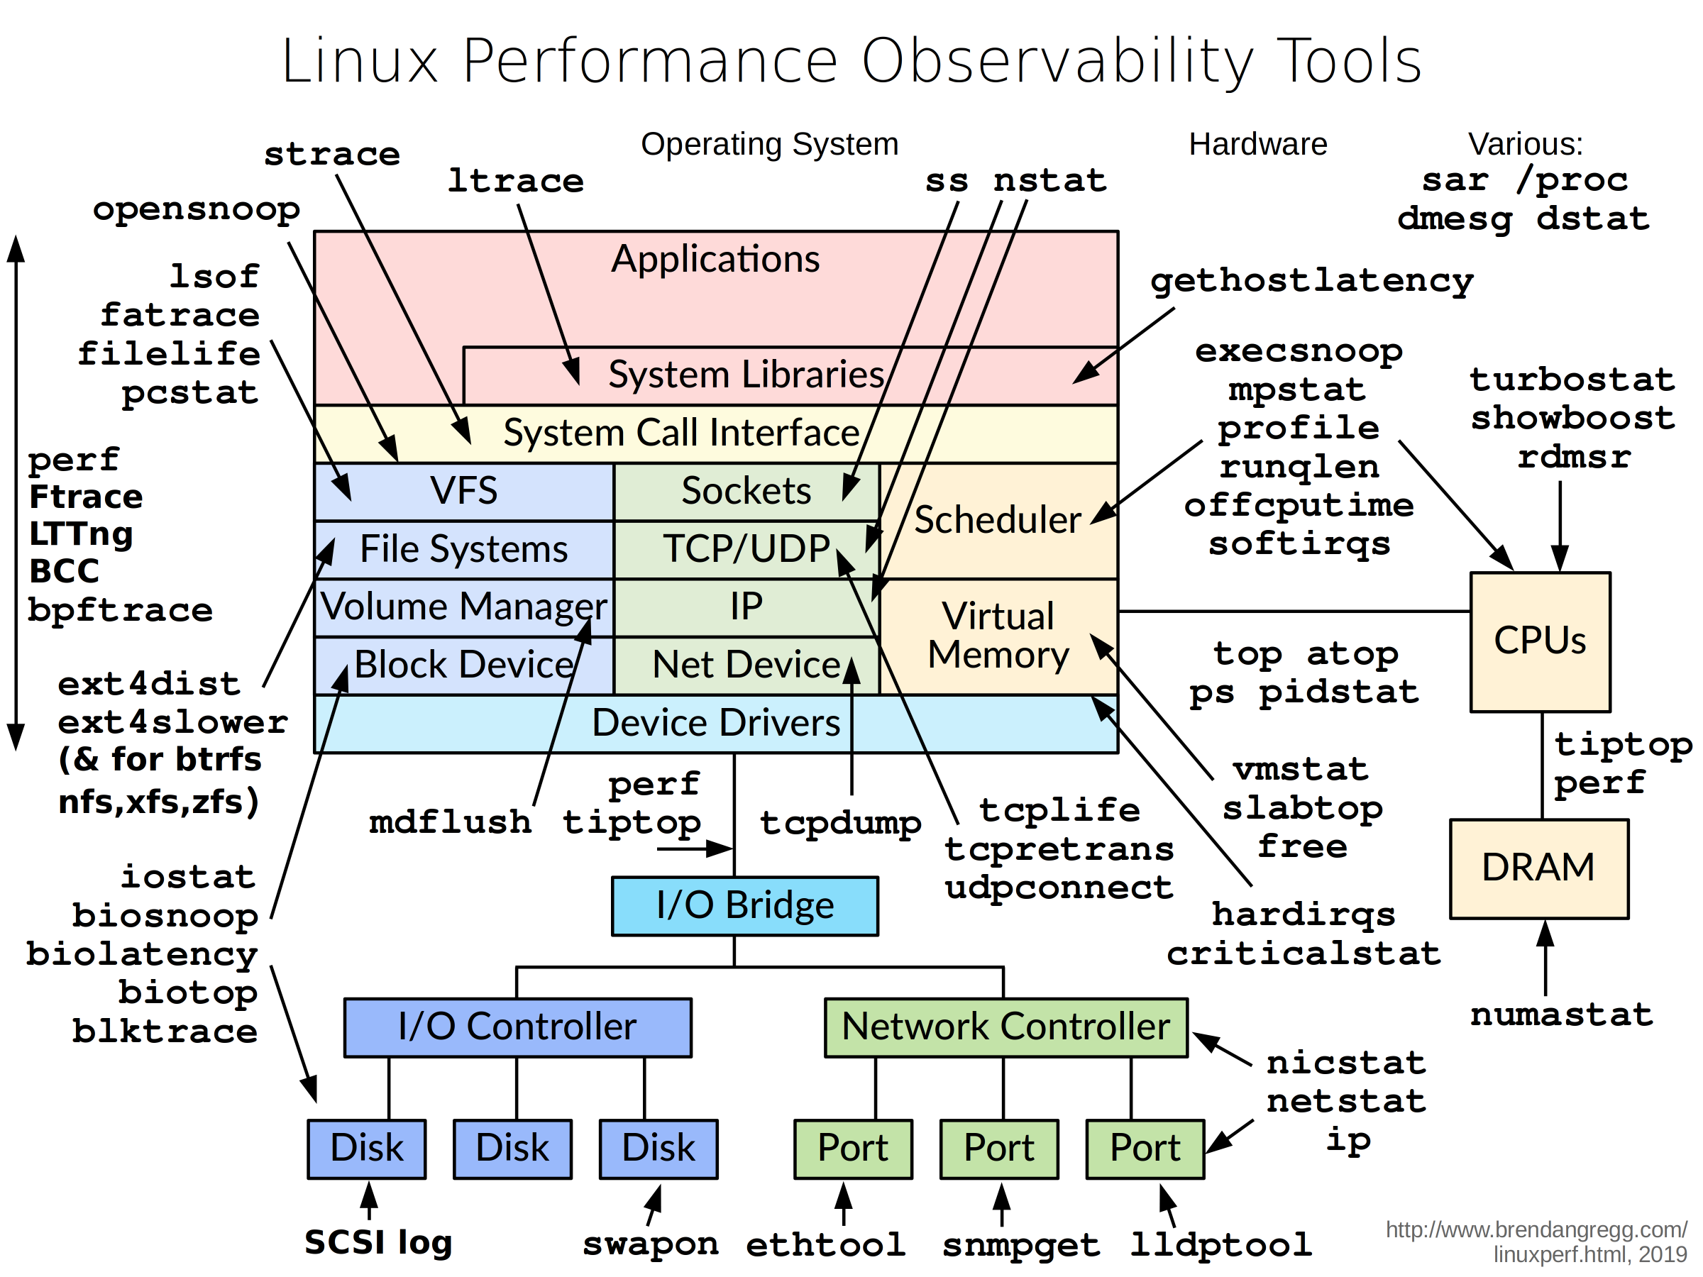
Notes:
overview of the tools, by Brendan Gregg
He is a performance engineer at netflix and if you ever have the felling of knowing linux, visit his website brendangregg.com
We will focus on the main high levels tools here for the CPU, memory, block devices and the network card
More importantly to know many tools is to read and interpret the output of the tools and know when to use which one

Slide 15
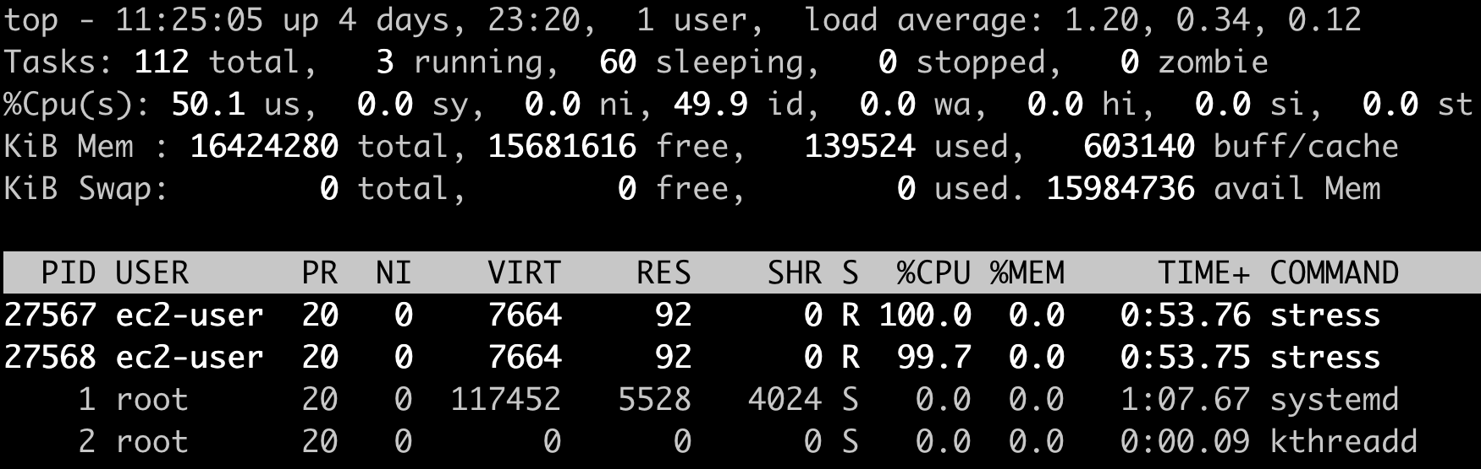
How to check CPU / memory status?
top/htop/atop/sar/mpstat/free/meminfo
ps / ps aux to see all processes
Notes:
While there are many different tools, the one tool that is used the most and readily available on most systems is top.
So let’s try to read the output. Everything that I will tell you now is from “man top”
load average: very high level metrics, shows how many processes on average have been in R or D state over the last 1,5,15 minutes
What can we see from the values here?
The load is increasing. In the last minute on average 1.2 processes were in the R or D state
This is a value for all CPU cores. It should not exceed the number of CPU cores
second line we can see three processes running with no zombies
I did run two processes to stress the CPU here. Anybody knows what is the third process, since it doesn’t show up in top at all in the process list?
it’s top itself, if more processes are running than expected or the number is very high, investigate
third line is the state the CPU has been in
us, user : time running un-niced user processes
sy, system : time running kernel processes
ni, nice : time running niced user processes
id, idle : time spent in the kernel idle handler
wa, IO-wait : time waiting for I/O completion
hi : time spent servicing hardware interrupts
si : time spent servicing software interrupts
st : time stolen from this vm by the hypervisor
If you see a high percentage in the last four states wa/hi/si/st, then investigate. (Mention steal for burstable instances here)
line 4 is the physical memory (RAM) and line 5 is the virtual or swap memory
total is total amount of memory
free is total-used-buff/cache
used is how much memory is actually allocated to processes
buff/cache is used by the kernel to speed up request, usually this caches data between the hard drive
memory management in linux is quite complex but unfortunately outside of the scope of this session
general warning signs here are when the amount of memory used is nearing the total memory
Since buff/cache can be reclaimed by the kernel if needed, a high value here does not indicate a problem
as a last resort the kernel will kill processes in order to stay alive, indicated by OOM killer in the system log
Then we see process specific information
The processes are by default in descending order based on their CPU load.
Like top itself, a process might be running but does appear in top. ps is needed here
PID -- Process Id
USER – user name
PR -- Priority
NI -- nice value
VIRT – amount of memory allocated to process ( wen can see here that memory is not our problem)
RES is the amount of memory actually used by the process, subset of VIRT
SHR is the amount of memory that can be shared that the process is using (via shared libraries)
S is the process state, R for running in this case
%CPU is the amount of CPU time the process is using. This is per CPU, so the value can go above 100%
%MEM amount of system memory used for the process
total CPU time consumed
COMMAND is the name of the command being executed ps aux useful for seeing all processes including the state So looking at all of this, do we have an issue here or not? (open question really depending on the amount of cores)

Slide 16
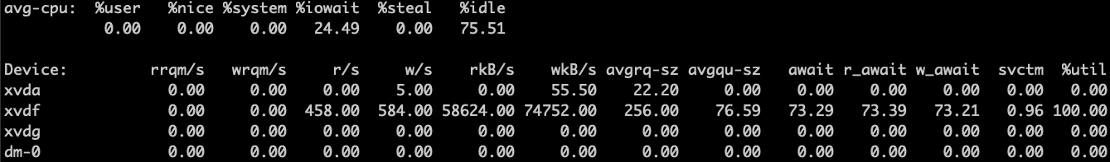
How to check disks status?
bandwidth = I/O number * I/O size
10 I/Os with a size of 128KB equal a bandwidth/throughput of 1280KB
58624+74752/(458+584) = 129.7
rkB/s + wkB/s / (r/s + w/s) = IO size
Notes:
Block devices can be HDDs, SSDs, Raids, EBS volumes and so on.
They will differ extremely in their performance
An old spinning disk will be cheap and have a decent bandwidth, but will be limited on IO, especially random IO, where SSDs will be much better for IO
But what is bandwidth and IO?
I/O is an input output operation, so a single request made to a block device to read or write something.
I/O can have different sizes, ranging from a few KB up to a few MB.
number of I/O * I/O size = bandwidth
The other important factor is the latency, which is the time needed from when the request is made to it being fulfilled.
A high latency will usually indicate an issue with the block device or a performance bottleneck.
But how do we measure it?
iostat for block device level
iotop for per process level
iostat is the high level tool here so let’s have a look at this output of iostat –x
x shows more information and is vital
What observations are you able to make from the output?
iowait is 24%
xvdf has load
458/584 read/write IOPS
58MB/s read and 74 MB/s write
average request size is 256, be careful here since this is an average over time, not per second to get the actual I/O size we need to calculate
await time is 73ms, which is not huge
%util is 100%, which means the device has been used 100% of the time In conclusion we know the device had an almost equal spread of read and writes with about 133MB/s and an IO size of around 130 How do we know if this is a problem or not? (iowait high, some await time, 100% util) Are we hitting an IOPS limit or the bandwidth limit? (we don’t know for sure) For most answers here we will need to know the expectations and what type of block device it is (gp2, 10GB hitting throughput limit)
Next would be to check which process it is, either by checking iotop or looking for processes in D state via ps.
We then see via ps, that there are multiple processes in D state named fio (which is the benchmarking tool used here)
iotop would have showed us the same.
This gives is a good amount of information and together with the type of volume we can conclude, that it is hitting the bandwidth limit and is not an issue but expected. No tweaking on the linux side has to be done here.
We have two options: Increase resource capacity or decrease load

Slide 17
benchmarking
stress - tool to impose load on and stress test systems
sysbench
fio
iperf
Notes:
Benchmarking does introduce an artificial extra load on the system to identify expected performance
stress is a useful tool to create load on a system, but does not really do a benchmark or produces a testing score
can be used for CPU/IO and memory
sysbench is a somewhat popular tool for benchmarking CPU/memory and IO
fio is great for IO testing and has many options
Let others do it for you ☺
If working with popular and established software, the vendor will give you advice on the type of hardware power needed depending on the scale of your deployment
Some vendors also only certify specific hardware like Red Hat, Suse or Oracle that they have tested beforehand
iperf3 is a network benchmarking tool to determine the network bandwidth between two systems

Slide 18
advanced tool (tracing)
strace for system calls
strace ls
lsof | grep <PID> to show open files of a process
perf = advanced performance observation and tracing
Notes:
Tracing tools will usually give you an in depth look into processes and workflows inside the operating system
They will impose additional load on the system and are to be treated with caution.
Some examples will be given here but it is much up to the student here to do further reading.
Whole books have been written about tracing tools, so it won’t be appropriately covered in a single slide.
strace is useful to trace what a specific process or script is doing, especially if it hangs at some point and it is not obvious why
lsof can be useful for tracing why a process is stuck in a D state amongst other use cases
perf is outside the scope of this session, but further information can be found in the man pages but better yet with examples on brendangregg.com

Slide 19
You should now be familiar with…
/proc
common commands
modules
performance benchmark

Slide 20
time for practice
1)
Launch two t2.small instances (Amazon Linux 2) in the same subnet.
Tasks:
a. Test and find out the network bandwidth limit for t2.small instance
Reference: https://aws.amazon.com/premiumsupport/knowledge-center/network-throughput-benchmark-linux-ec2/
b. Run the test for 300 seconds, find out how long the network throughput can burst?
Extra question: How can you find the network bandwidth info on the AWS side?

Slide 21
time for practice
2)
get system information from /proc display free memory amount of cpus kernel version uptime
3)
practice with the stress tool and observe behavior in performance observation tools

